Slide 1
CLOUD COMPUTING PROJECT
TEAM MEMBERS:
Changzheng Ma
Yang Liu
Kexuan Ma(Jessie)
Karthik Mannava

Slide 2
Table of Content
Requirements and Sources
Function point and Problem
Solution and Architecture
Capacity Tendency
Cost Selection
Optimization Consider

Slide 3
Requirements and Sources

Slide 4
OBJECTIVE
To provide the client with the necessary services
Achieve High-Availability

Slide 5
USERS
User requirement:
Gaming services which include book games like Sudoku, snakes and ladders, connect the dots and online gaming etc.
Who are the users:
Magazines
Schools
Companies

Slide 6
Function point and Problem

Slide 7
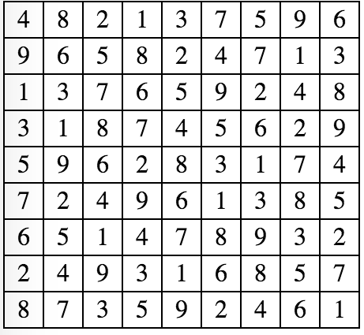
Application
Sudoku application
We provide the users with the Sudoku solution

Slide 8
Problems
Lack of computing resources when the numbers of users accessing the application are increased
High response time when users accessing the application are increased
Hardware fault

Slide 9
Solution and Architecture

Slide 10
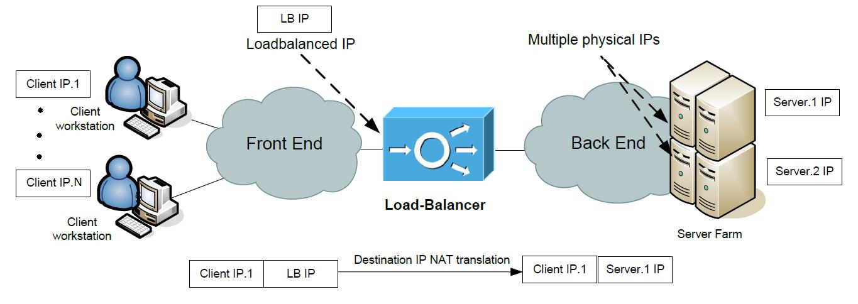
Solution
A solution is to have multiple servers run the application.
The distribution of traffic between the servers is handled by load balancer (which is another server)
If for some reasons one of the servers is down (for maintenance) , the load balancer redirects traffic the other available instances

Slide 11
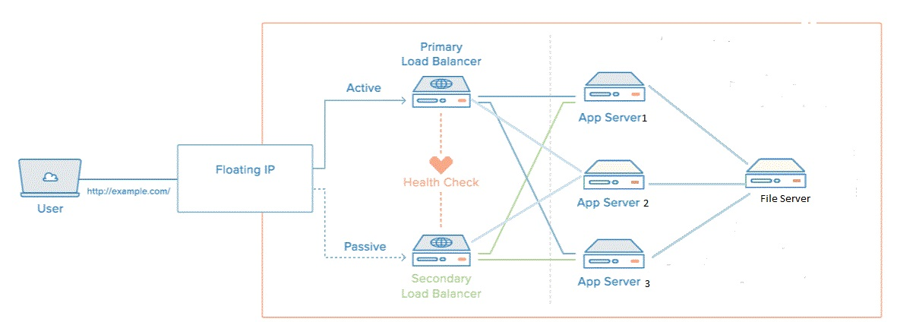
Improvement on the Solution
If for some reason the load balancer distributing the traffic is down (example : maintenance). We have a back up load balancer to keep our application service running without any downtime.

Slide 12
Sudoku Library
How it works :
Building application to generate a random valid Sudoku result (coding in PHP).
Saving the Sudoku result to a text file (using fopen() and fwrite() functions).
Uploading the file to the file system (using mount command).

Slide 13
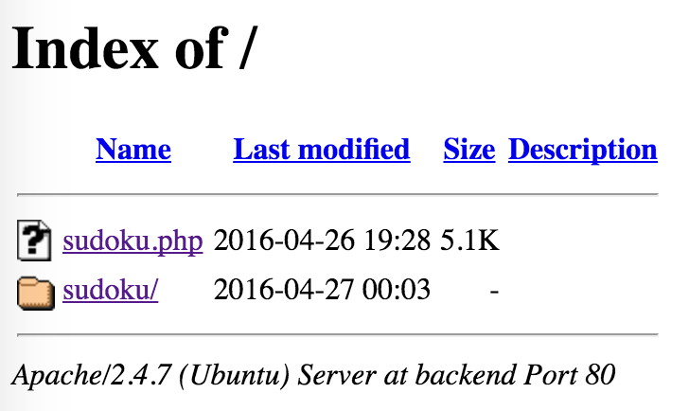
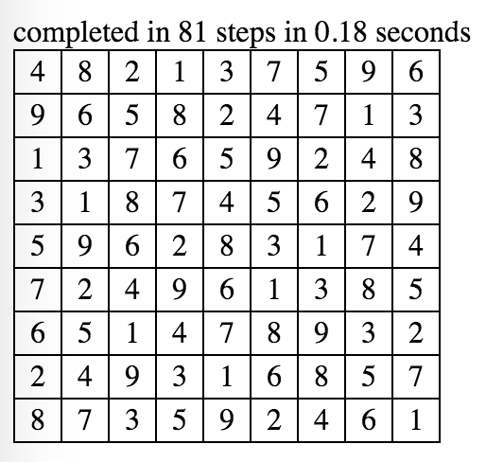
Sudoku Library
When connect to load balancer..
When you access sudoku.php.

Slide 14
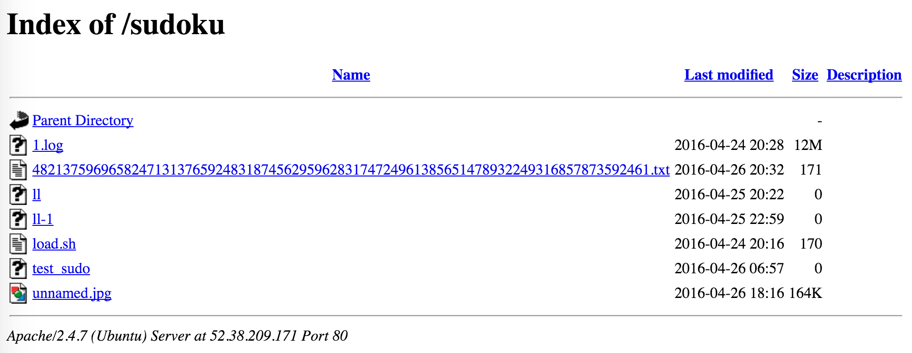
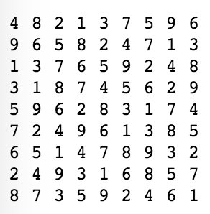
Sudoku Library
We use the content of Sudoku answer as the file name to avoid duplicates.
This is how we store the Sudoku answers..

Slide 15
Capacity Testing Procedure:
Tool used to test the capacity of the system: JMeter
Connecting JMeter to the Virtual IP of Load Balancer and add “/appname”.
We will monitoring the usage data of each server and increasing the threads in JMeter until each server reaches 100% CPU usage.
Record the throughput data in JMeter.
Record the usage information of all the servers.

Slide 16
Results of Capacity Testing
THREADS | THROUGHPUT | CPU USAGE OF EACH SERVER
1 | 4.5 per second | 30 %
2 | 9.0 per second | 60 %
3 | 13.1 per second | 90 %
4 | 15.0 per second | 100 %

Slide 17
Procedure for Failure Tolerance Test
Application used – sudoku.php
We have three servers running the application and one load balancer
Running JMeter to access the application continuously
Stop one server.
Search the access.log files of each server to see the connections.
URL of Data: https://github.com/mchzh/CSYE6225-Project-Sudoku/tree/master/log

Slide 18
Results of Failure Tolerance Test
Before stopping one of the servers, the number of connections on an average for each server per second was calculated to be 4.6 connections per second.
While we are stopping one of the servers, the total number of connections to the other two servers is about 5.4 connections per second and the instance that is being stopped has no connections. (This indicates that the load balancer starts redirecting the traffic to the available servers)
The number of connections on an average is 4.6 connections per second after the server has been restarted.

Slide 19
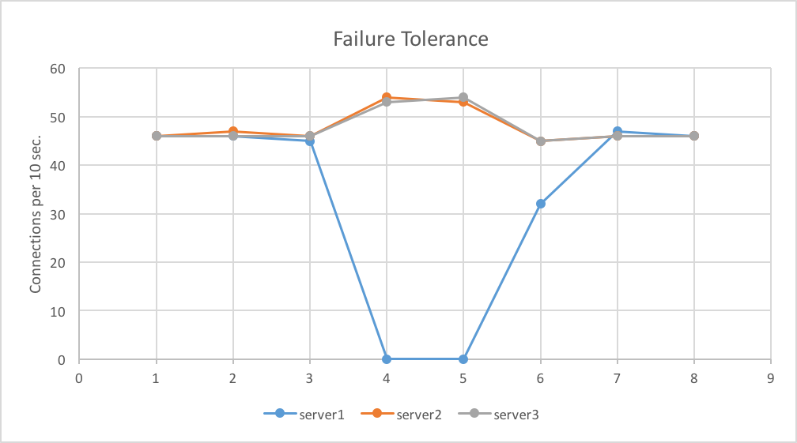
Graph Result

Slide 20
Backup Load Balancer Test
Running JMeter to access the application continuously
Shutdown the primary load balancer. (we just want to show if one day our load balancer doesn’t work, whether the whole system will recover itself automatic)]
Just after 9 seconds, whole system works again!
Notes:
The Virtual IP is taken over by the secondary load balancer. There was a 9 seconds interval between the transfer.

Slide 21
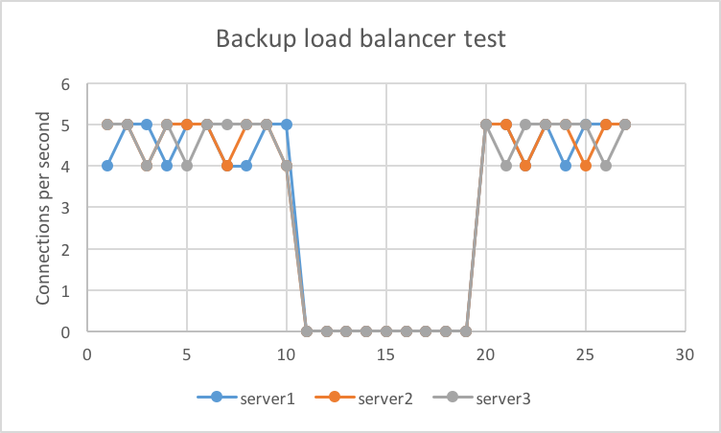
Graph Result
Notes:
The Virtual IP is taken over by the secondary load balancer. There was a 9 seconds interval between the transfer.
The Virtual IP is taken over by the secondary load balancer. There was a 9 seconds interval between the transfer.

Slide 22
Unified File Service
Several Linux native file systems are currently in widespread use, including ext2, ext3, ReiserFS, JFS and XFS. Additional native file systems are in various stages of development.
Independent model use connect variety client include web service
Apache2 mount share directory

Slide 23
File Service-Model
Client-Server model: different instances can share a file system
NFS
Service
NFS
Service
NFS
Service

Slide 24
File Service-Nfs install and use
Server: nfs-kernel-server
Client: nfs-common
Settings: /etc/exports, /etc/fstab
Server control what client privilege can visit which disk or volume

Slide 25
Capacity Tendency

Slide 26
Capacity planning
Easy extension (only add instance)
Business no interrupted (new instance do not influence old one)
Overall deployment (the whole group architecture adding)
Backward compatibility (new function can replace step by step)
Safety (http and https seperately)
Interface clear (model independently each other)
Scalability (new service easy adding such as DB)

Slide 27
User Curve
The number of users will increase with the time because our platform spread to many domain including market, school, IT company and government etc. The development will experience three stages:
1. Early days, about 100 to 500 test users;
2. Mid-term times, users number will turn 3 to 5 times and reach under 50000. Meantime, in this stage users number will keep a stability level because our platform must add function and adjust some deployment;
3. Late stage, we will spurt development with the complete of this platform.

Slide 28
Http Request
Http request estimation:
1. Every user average 30 requests per hour;
2. Every user average use 4 hours per day;
3. Max user amount is 200,000 per day in this year;
So a day max requests is :
30 * 4 * 200,000 = 24,000,000 requests
4. Max user amount in a second is 30,000 online at the same time
max concurrency number also 30,000
5. Estimate every data to change two times than the pre year

Slide 29
Cost Selection

Slide 30
Cost Calculation
From peak value and average value to calculate:
1. LB must accommodate peak http request(30,000)
Every group LB can deal 10,000 requests, so we need 3 group LB;
2. Apache2 application must accommodate the whole http request(24,000,000)
Below LB an application cluster can deal 8,000,000 requests, so we still 3 application cluster
3. Every LB and application cluster need a file server
4. Every file server can maximum mount 40 volumes.
So the device amount is:
3*2 = 6 LB instances(HA)
3*3 = 9 Application instances
3 File instances

Slide 31
Selection
According 3 different model characteristic, select 3 device type with different configuration.
LB: m4.large (High CPU and Memory, no disk)
Application: m3.xlarge(High CPU and Memory, some SSD)
File Server: c3.large(Low CPU and Memory, High SSD)

Slide 32
Optimization Consider

Slide 33
Improvement
Several strategy:
1. Put HA mechanism into File system;
2. Use domain name instead of IP address for every model like unified file service;
3. Add batch model and database model to support user behavior analysis;
4. In application instances cluster apply manage node and compute node in order to implement Resilience;
5. Build CDN to balance and distribute our network requests.
NOTE: All these measure help our system fullfill Loose coupling High cohesion.

Slide 34
Appendix
1.Github resource URL:
https://github.com/mchzh/CSYE6225-Project-Sudoku
2.FAQ:
LB HA monitor backup display "Network unreachable" when shutdown the primary LB.
After mount the NFS server share directory in client, it can read the file of file server but not update and add file.
Run nginx load balancer setup automatically when the instance is

